Slide 1

No more magical webservices
Feat. ServiceStack

Slide 2

Why am I here…
Stefan Daugaard Poulsen
AP in Computer Science
Developer (and architect) at Atea Denmark
.NET developer since 2002
Silverlight developer back in 2011 with high use of WCF
“Caught” in a discussion about webservices in November
Got annoyed by RPC style, code-gen webservices

Slide 3

What are bad ideas for webservices
Code-gen
It fails…too often
Archaic Xml configuration
Distribution, misspelling…or even horrible merges
Defaults that is bound to make you cry
Why do I need to set values that should be default!
Fixed serialization
Could be nice to talk to more systems no matter who they are
RPC style services
Maintenance hell
Chatty services
Bulk it!

Slide 4
What is this ServiceStack thing
Official subtitle:
Web Services done right, REST services done easy :)
Simple and model-driven
Endpoint ignorant
IoC based
Easy access to HTTP
Fast as lightning
Cross platform
Oh!... And clients are in the box

Slide 5
Unboxing from NuGet
Currently
ServiceStack
ServiceStack.Text (Serializers: JSON, JSV, CSV)
ServiceStack.Common
ServiceStack.Redis (Fastest Redis client)
ServiceStack.OrmList.SqlServer (Micro ORM, POCO based ofcourse)
My wishlist:
ServiceStack
ServiceStack.Text
ServiceStack.Common

Slide 6

Gentlemen, start your engines…
IService
ServiceBase
RestServiceBase

Slide 7
Endpoint ignorant
JSON
Xml
JSV
CSV
SOAP
1.1
1.2
Custom

Slide 8
Clients
Client interfaces
IServiceClient
IRestClient
IRestClientAsync
Implementations
Soap11ServiceClient (only for IServiceClient)
Soap12ServiceClient (only for IServiceClient)
JsonServiceClient(Async)
JsvServiceClient(Async)
XmlServiceClient(Async)
Or you can hookup to the XSDs or WSDLs as well
Might be handy when delivering services to external partners

Slide 9

It’s a freaking swiss army knife!!!
OrmLite
SqlServer
MySQL
PostgreSQL
Sqlite 32 & Sqlite 64
Firebird
Authentication
MongoDB
NHibernate
Caching
Memcached
Azure
Protobuf
Logging
NLog
Log4Net
ELMAH
Eventlog

Slide 10
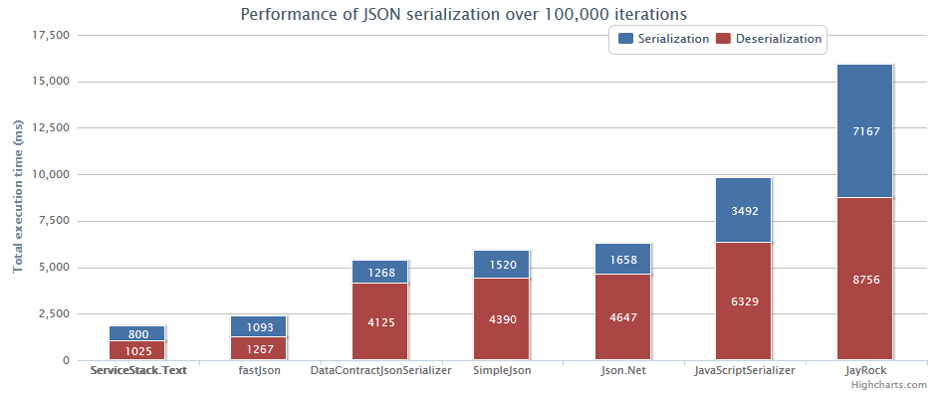
I’m in the need for speed!
Fastest JSON serializer
Burning Monk JSON Benchmarks (12/11/2011)

Slide 11

Crossplatform
Supports ASP.NET and HttpListener hosts
Runs on Windows with .NET 3.5 and 4.0
IIS 5/6/7 (uses IHttpHandler)
VS.NET WebDev Server (Cassini)
IIS Express
Console App, Windows Gui, Windows Service
Linux/OSX with Mono
Apache + mod_mono
Nginx + MonoFastCGI
XSP
Console App
A demo have been done inside iOS with MonoTouch

Slide 12
Where is it hidden?
Source: https://github.com/ServiceStack
Wiki: https://github.com/ServiceStack/ServiceStack/wiki
More docs: http://www.servicestack.net/docs/

Slide 13
Who’s behind this thing …and do I dare use it for production
Main contributor: Demis Bellot (@demisbellot)
Currently creating awesomeness at StackExchange
It’s been around for a while
First commit Dec 21, 2008
It is well maintained
Currently at version 3.8.3
Was 3.2.0 back at Jan 8 2012

Slide 14
That’s all folks
Twitter: @cyberzeddk
Blog: http://cyberzed.dk
Email: cyberzed@sleddog.dk
P.S. You should checkout http://code52.org/

